Slide 1
Do Now
Get a computer and sign in to your Turnitin Account.
We are going to go through the steps to turn in your final draft today, then you will finish writing your essay.

Slide 2
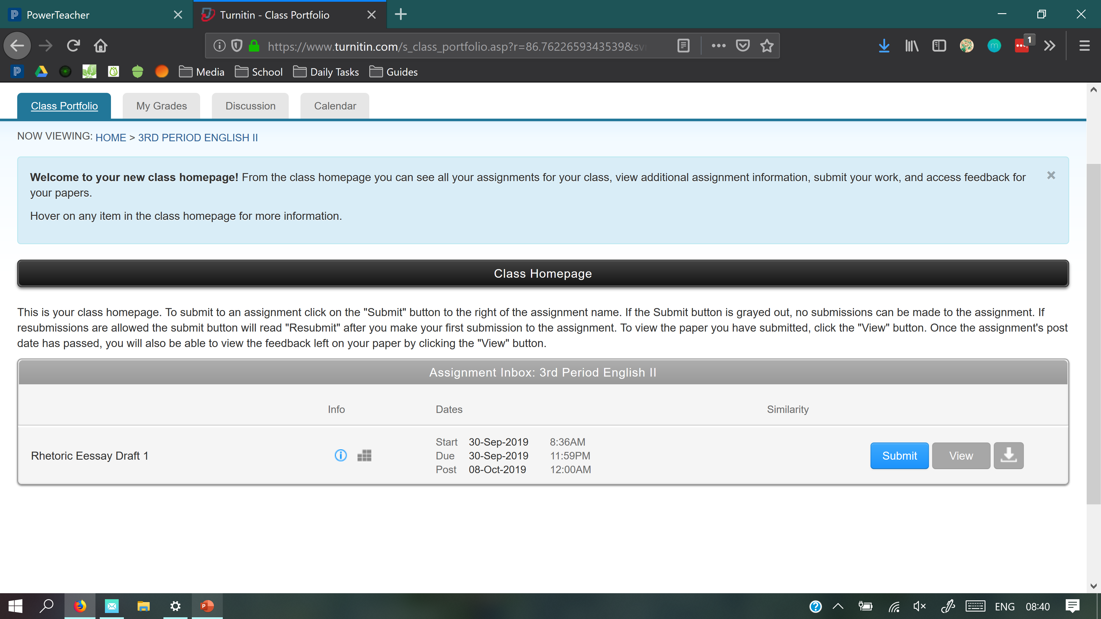



Slide 3
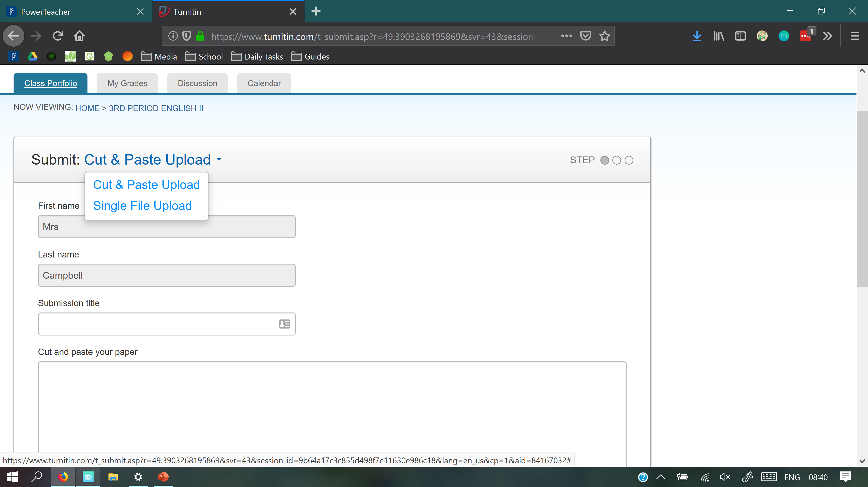












Slide 4
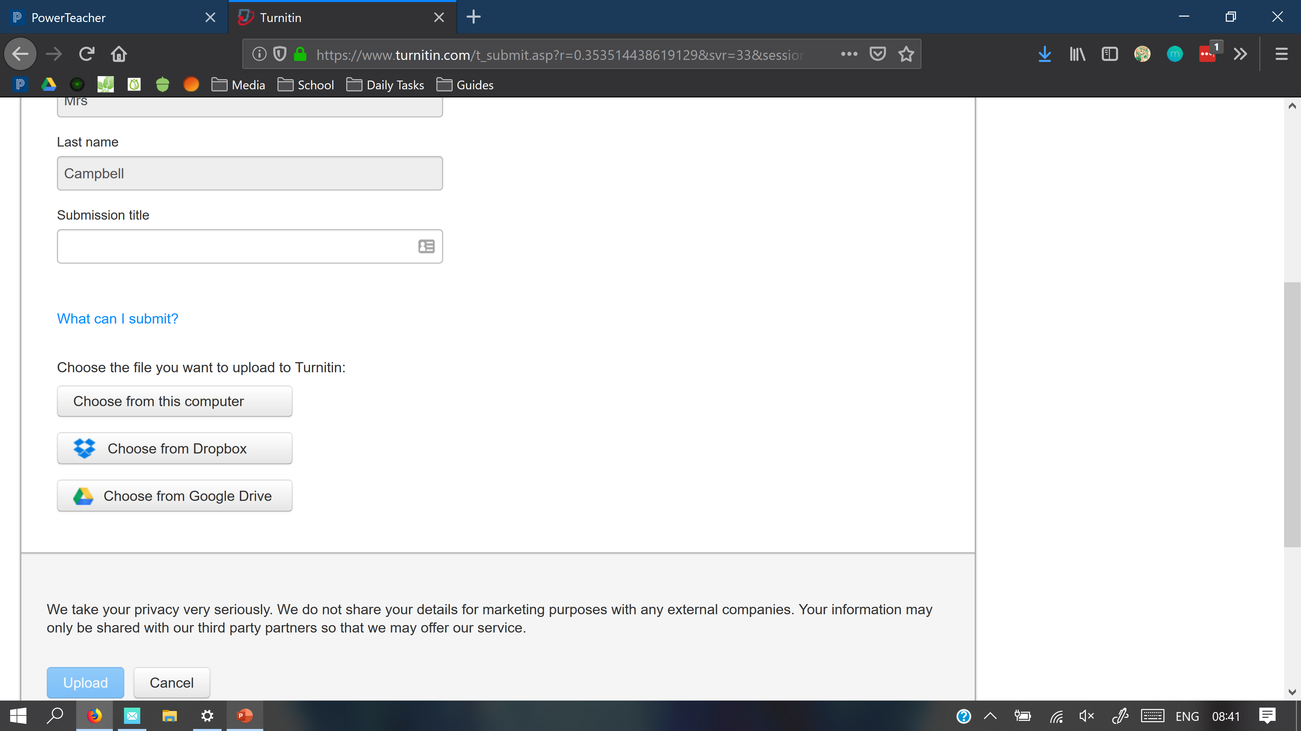







Expository Essay

Slide 5
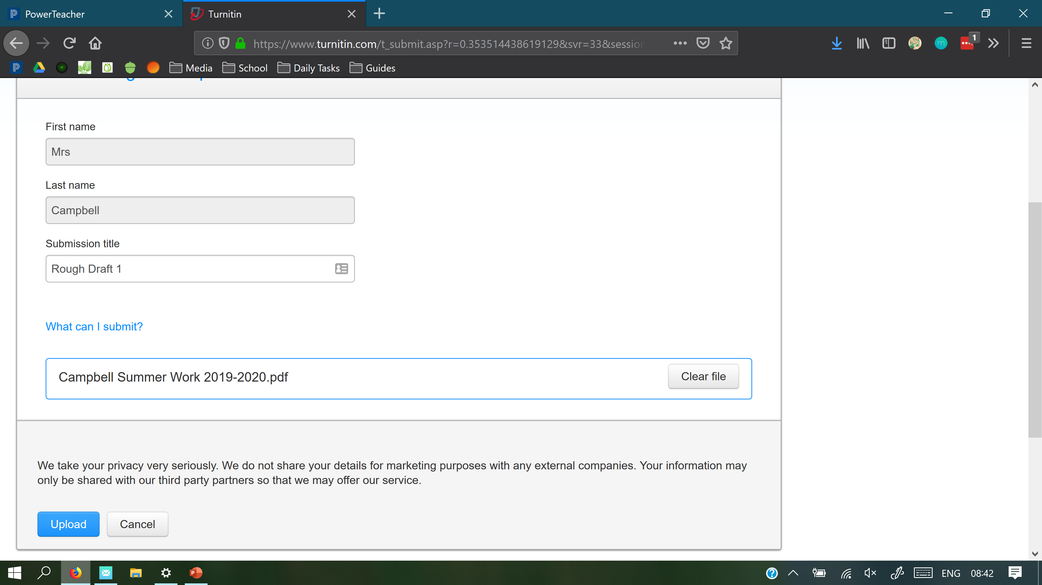










Mr.
Smits
Smits Expository Essay.pdf

Slide 6
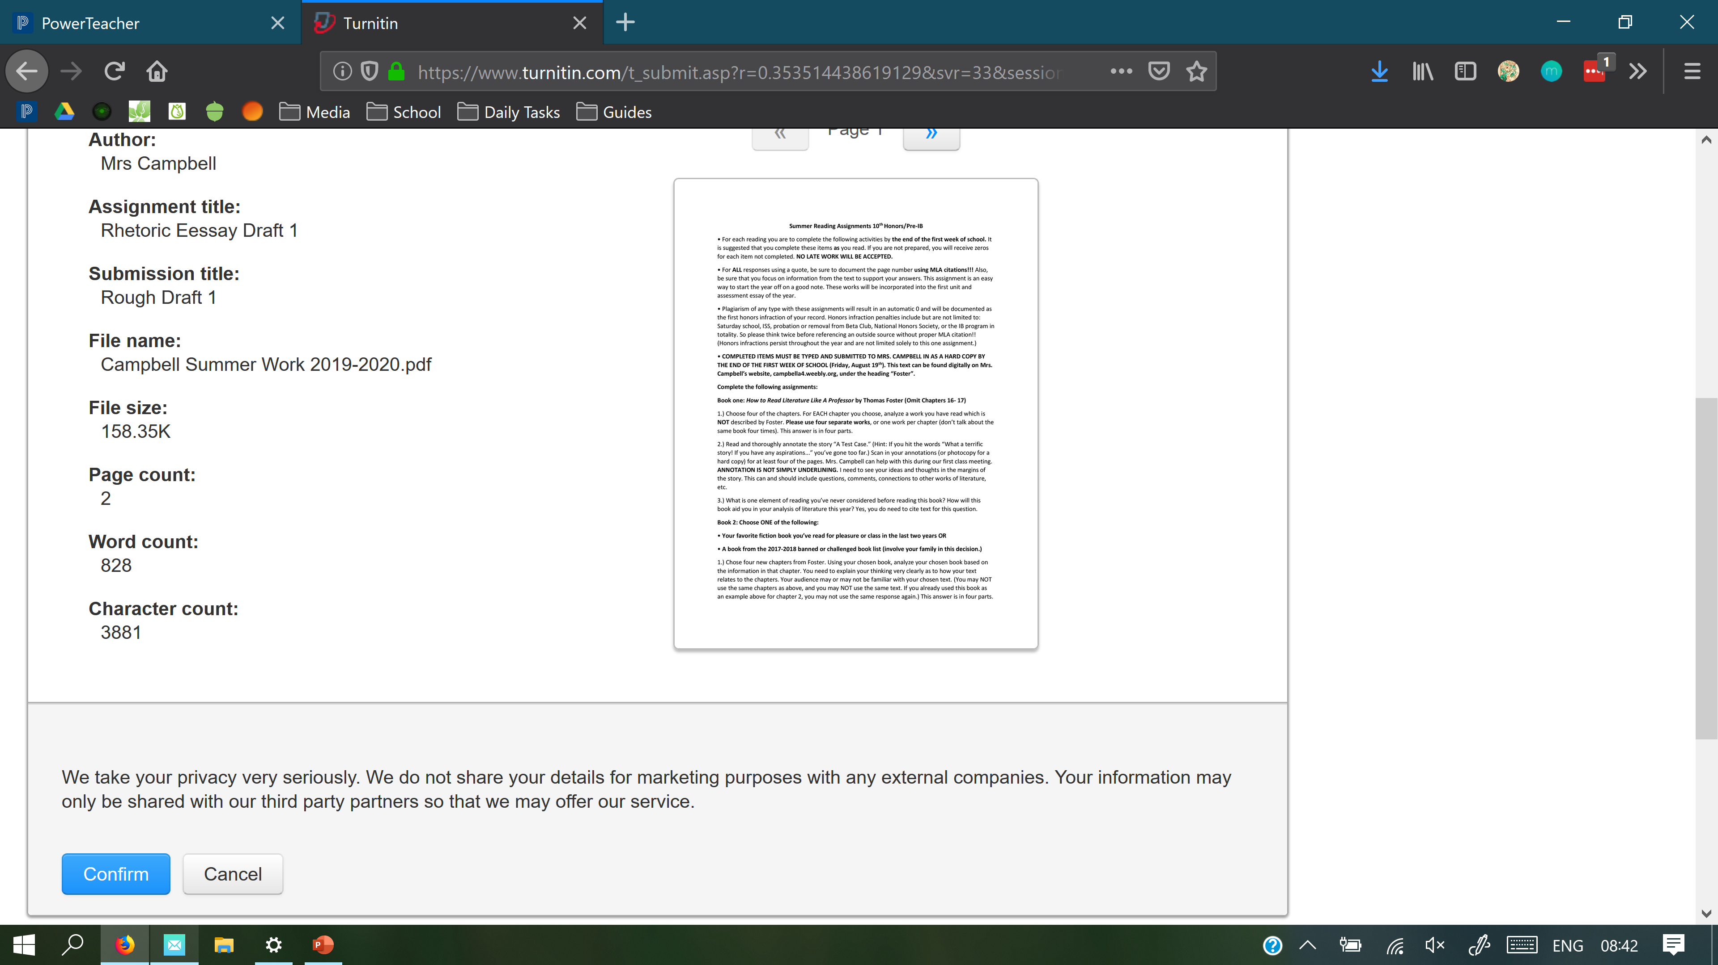













Mr. Smits
Smits Expository Essay.pdf

Slide 7
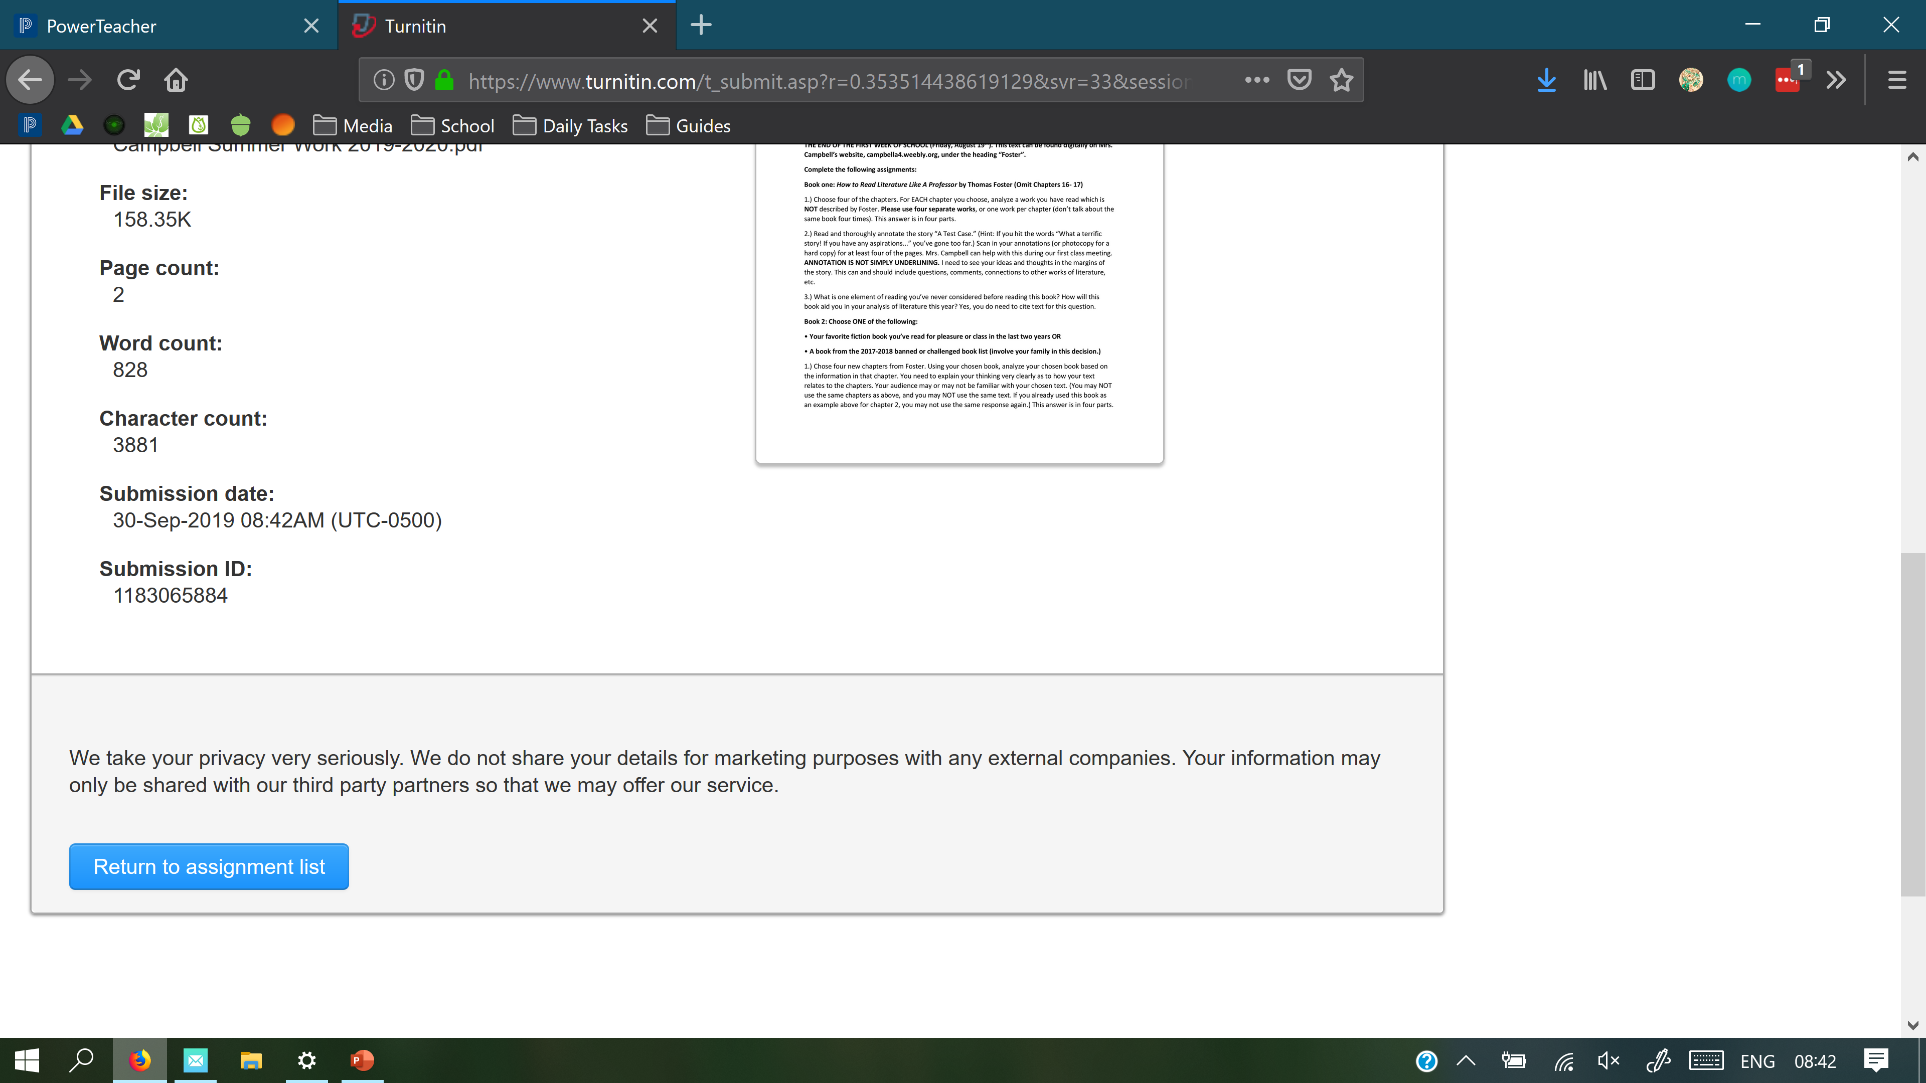













Slide 8
