Slide 1
Do Now
Pull out your notebooks and clear your desks.
Read the following quote. Write down in your bell work whether you agree or disagree with it and why you think that way. Provide examples from your own life.
“If you find a path with no obstacles, it probably doesn’t lead anywhere.”
-Anonymous

Slide 2
Making an Outline
A Plan That Builds an Essay
Essay
------------------- ---------------------

Slide 3
What is an outline ?
Before you begin writing the first
draft of your essay, it is best to make
an outline. An outline is a general
plan of what you are going to write.
You can compare making an outline
to drawing plans to build a house.
Before one begins to build a house, it
is best to draw up plans to make sure
that a house is built in the way you
want. The same is true with writing
an essay and making an outline.

Slide 4
The Benefits of an Outline
An outline of an essay can be very helpful for two reasons:
An outline will help make your essay more
organized. A careful plan will help your body
paragraphs stay focused on the ideas in your
thesis statement.
An outline saves time for writers. Preparing an
outline can take time, but when you are finished,
you will be able to write the rough draft of your
essay more quickly than if you didn’t have an
outline.

Slide 5
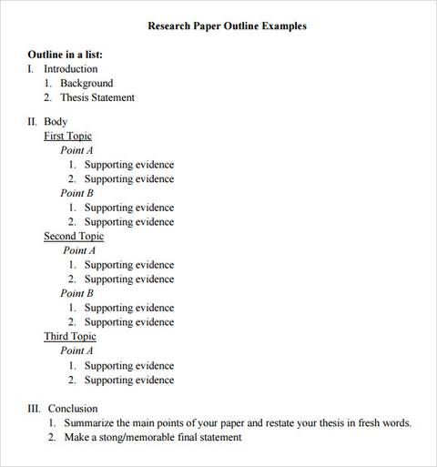
Example Outline
Claim
2-3 reasons
Evidence for each reason

Slide 6
The Process
Introduction
In your introduction, you’ll need a hook, introduction of topic, and thesis. For the outline, we’ll just put our background and thesis.
Background should be a very short summary about the text you’re using leading into your thesis.
Example: In Susan B. Anthony’s address to the court after being indicted for voting, she discusses why women should not be arrested for voting because it is a human right to be able to have a voice in government.

Slide 7
The Process
Thesis Statement
To begin an outline, you need to start with your thesis statement.
The thesis statement will be your guide throughout the process of writing your essay.
From the thesis statement, you can begin writing the topic sentences for the body paragraphs in the outline.
ESSAY OUTLINE
Thesis Statement
Topic Sentence #1
Topic Sentence #2
Topic Sentence #3

Slide 8
The Process
Topic Sentences
Thesis Statement
In “Is It A Crime for a Citizen of the United States to Vote?”, Susan B. Anthony’s use of rhetoric is effective because she utilizes logical reasoning and appeals to the reader’s emotions in order to communicate her argument that women should have the right to vote.
Topic Sentence Paragraph #1:
Anthony appeals to the reader’s sense of logic by using a founding document as the central evidence as to why women’s rights should be equal in the United States.
Topic Sentence- Paragraph #2:
In addition to using logos, Anthony also lists wrong done to women, which angers the reader because they can see the injustice taking place.

Slide 9
The Process
Topic Sentences
The topic sentence for each body paragraph
should support the thesis statement.
The topic sentences need to agree with the main idea or subpoints in the thesis statement; otherwise, the essay could be confusing.

Slide 10
The Process
Supporting Details
Under the topic sentence for each paragraph,
list some of the supporting details, examples,
or ideas you want to include in each paragraph.

Slide 11
The Process
Supporting Details
II. Body Paragraph #1:
Topic Sentence: Anthony appeals to the reader’s sense of logic by using a founding document as the central evidence as to why women’s rights should be equal in the United States.
A. The Declaration of Independence constantly discusses equality.
B. “The Declaration of Independence, the United States Constitution, the constitutions of the several states and the organic laws of the territories, all alike propose to protect the people in the exercise of their God-given rights.”
C. The Declaration does not give rights. Everyone has them, but the United States has not given them freely as it should.
supporting details,
examples, and ideas

Slide 12
The Process
Conclusion
For the conclusion, you summarize the thesis statement and main points in fresh words.
You will also want to end with something memorable!
The outline for the conclusion should just brainstorm your ideas on what you will say here.

